Slide 1


TEAM MEMBERS:
P. Penchala Teja
Allagadapa Harish
Harshit Gupta
Raghav Sharma
Bibhakar Paul

Slide 2

OBJECTIVE
The purpose of this job analysis is to provide a comprehensive understanding of the various job positions in India which is posted on Linkedin.This job analysis will encompass all key job positions in different companies, spanning across departments and divisions. We will examine the duties, responsibilities, qualifications, skills, and competencies required for each position.

Slide 3
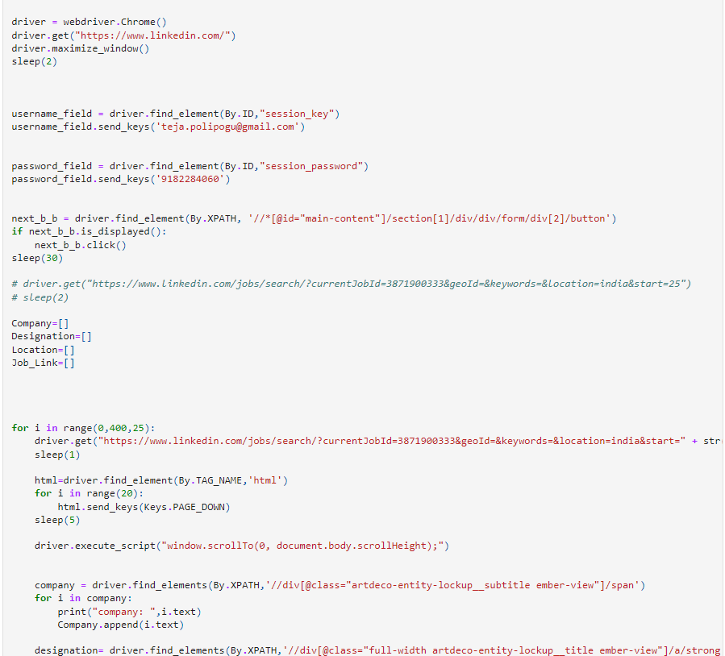
EXTRACTION
Data extraction serves a pivotal role, particularly when faced with the intricate task of obtaining data page wise and scrolling the page.To overcome this challenge, we strategically used loop on link of each pages for a seamless and efficient extraction process.

Slide 4
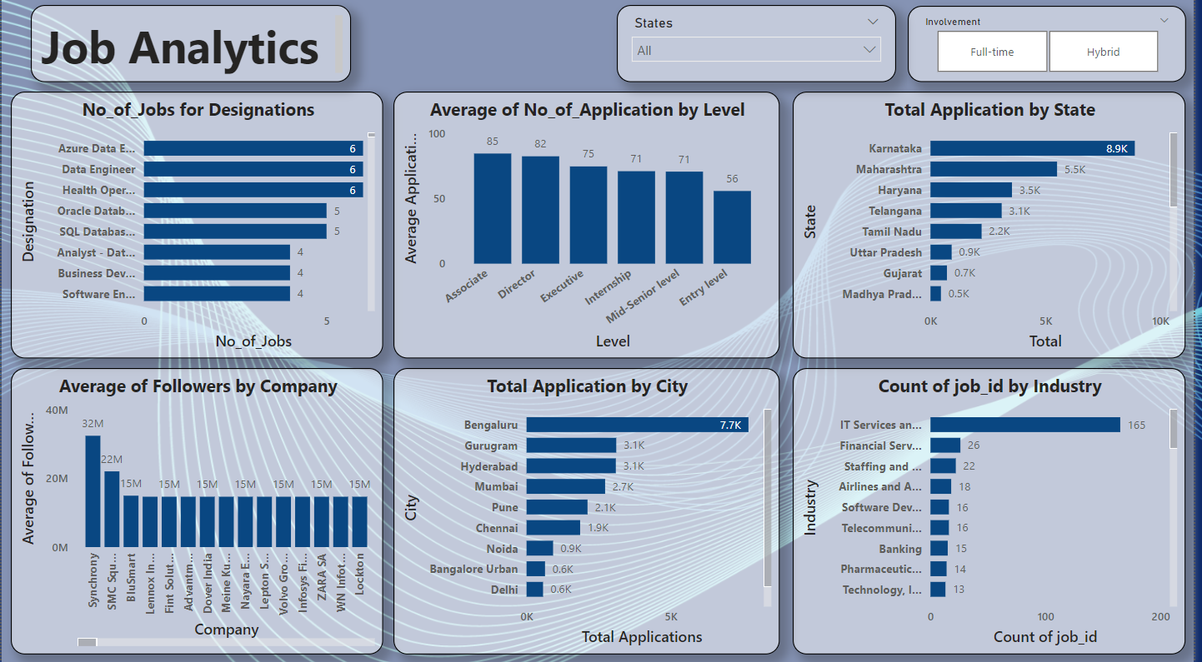
DASHBOARD
Integrating data from multiple sources with different formats and structures, and cleansing it to ensure accuracy and consistency.
Compare job postings and recruitment metrics with competitors in the industry.
Visualize the trend of job postings over time to identify fluctuations and patterns in job demand.

Slide 5
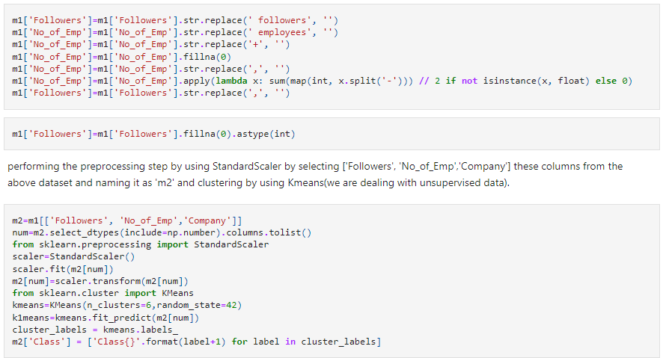
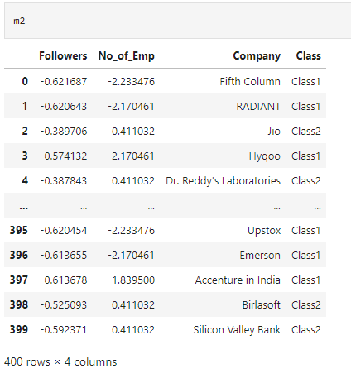
CLUSTERING AND NLTK
Use clustering algorithms to categorize companies based on attributes such as employee count and LinkedIn followers. This categorization can help in understanding market segments and identifying patterns among different types of companies.
Apply clustering algorithms to analyze and visualize patterns in the data. Use NLTK for additional analysis tasks, such as sentiment analysis or skill extraction, to gain deeper insights into the clustered data.

Slide 6
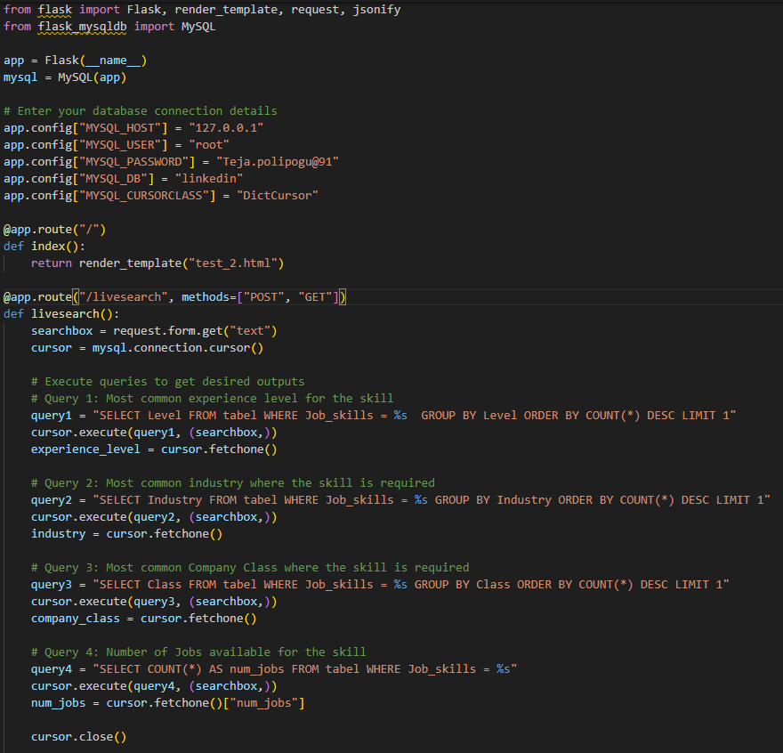
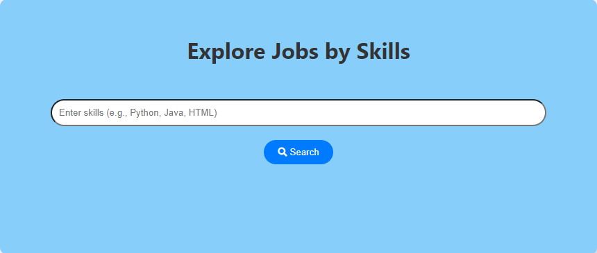
SEARCH BAR
One of the primary challenges encountered was loading data into the search bar efficiently. This involved integrating the search functionality with the backend database and ensuring smooth retrieval and display of search results.
To address this challenge, extensive research was conducted into various methods for data retrieval and integration with frontend components. Ultimately, a combination of MySQL connection requests and server-side APIs was implemented to fetch and display search results dynamically. Additionally, caching mechanisms were employed to optimize data retrieval and minimize latency.

Slide 7
CHALLENGES AND LEARNINGS OUTCOMES
Challenges:
Extracting relevant skills and qualifications from unstructured job descriptions.
Dealing with special characters, punctuation, and typos in search queries.
Providing real-time updates to search results as the user types.
Supporting complex search queries with multiple filters, operators, and conditions.
Learning Outcomes:
Enhance programming skills in languages such as Python, PowerBI, or SQL for data manipulation, analysis, and visualization.
Learn to leverage libraries and frameworks such as pandas, scikit-learn, and matplotlib for data analytics tasks.
Learn techniques for ensuring cross-platform compatibility and responsiveness of the search bar across different devices and browsers.
Gain proficiency in version control systems such as Git for managing code changes, branching, and collaboration with team members.
Develop skills in error handling and debugging to identify and resolve issues that arise during search implementation.

Slide 8


